Slide 1

the margin of error in a confidence Interval estimate
Presented by:
Course:
Date: 1st November 2019

Slide 2
WHAT IS MARGIN OF ERROR?
Margin of error refers to the range of values below and above a statistic in a confidential interval.
Margin of error can be defined by the following equations;
  Margin of error = Critical value x Standard deviation of the statistic.
  Margin of error = Critical value x Standard error of the statistic.
Notes:
The method is appropriate when sampling from a normally distributed population where the population standard deviation Sigma is known.

Slide 3
FACTORS THAT AFFECT MARGIN ERROR IN A CONFIDENCE interval estimate
the sample's size
the variability of the population (expressed as its standard deviation)
the confidence level of the estimate

Slide 4
1. the sample's size
The greater the sample size, the more information is available thus likelihood of being close to representatives.
In other words, when the sample size is small, the margin error increases. When the sample size is large, the margin level is decreases
Notes:
The two entities move in different directions, hence called inverse relationship.

Slide 5
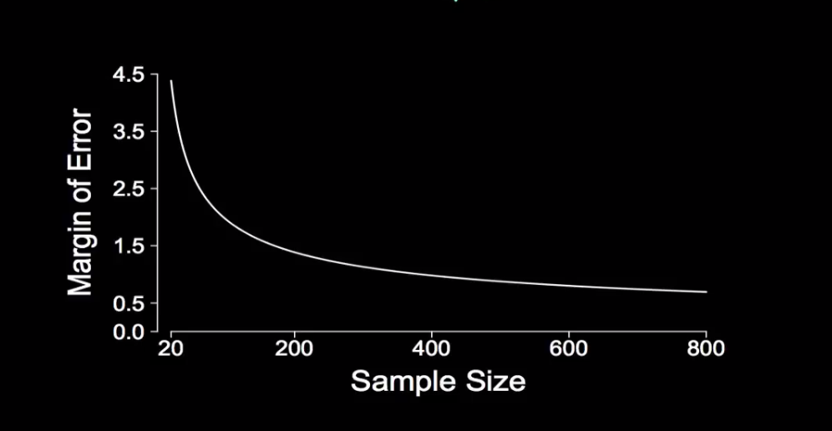
Illustration

Slide 6
When we increase the sample size from 20 to 200, there is a vivid reduction in the margin of error, but an increase in the sample size of 600 to 800 doesn't have nearly the same effect.
Hence as the sample size increase at some point there is no significant change on the Margin of error.

Slide 7
2. the variability of the population (expressed as its standard deviation
The margin of error increases linearly with the standard deviation Sigma.
All of their factors being equal, a doubling of the standard deviation would result in a doubling of the margin of error.
Notes:
In standard deviation, the more inconsistency in the sample, the higher the chances of error, therefore, the greater the sample standard error and margin of error.

Slide 8
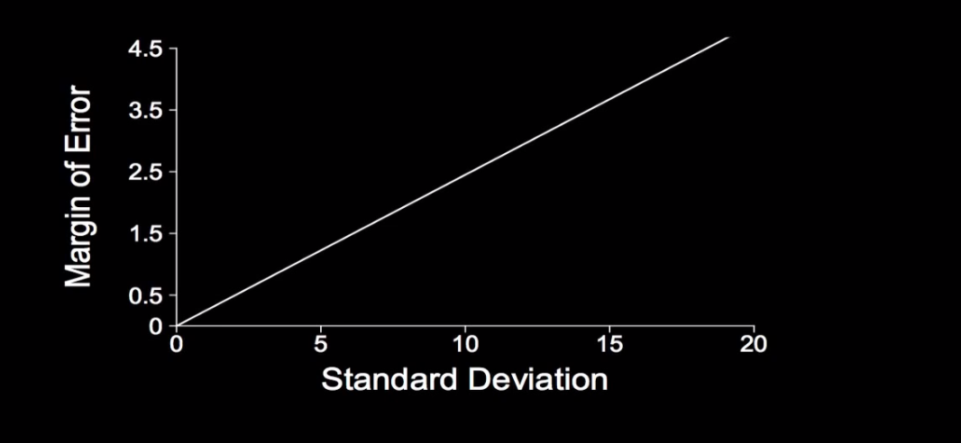
Illustration

Slide 9
The greater the standard deviation, the greater the uncertainty.
This means the more difficult it is to identify the value of the parameter of interest as the standard deviation increases.

Slide 10
3. The confidence level of the estimate
Greater confidence level, has to be from a greater margin of error.
The relationship between the margin of error and the confidence level holding all other factors equal, should be consistent up to 95%.
Beyond the 95% confidence level, the margin level tends to skyrocket.
Notes:
Confidence levels is closely associated to sample size.
For accuracy purposes, it is best to choose a higher confidence, preferably up to 95%.

Slide 11
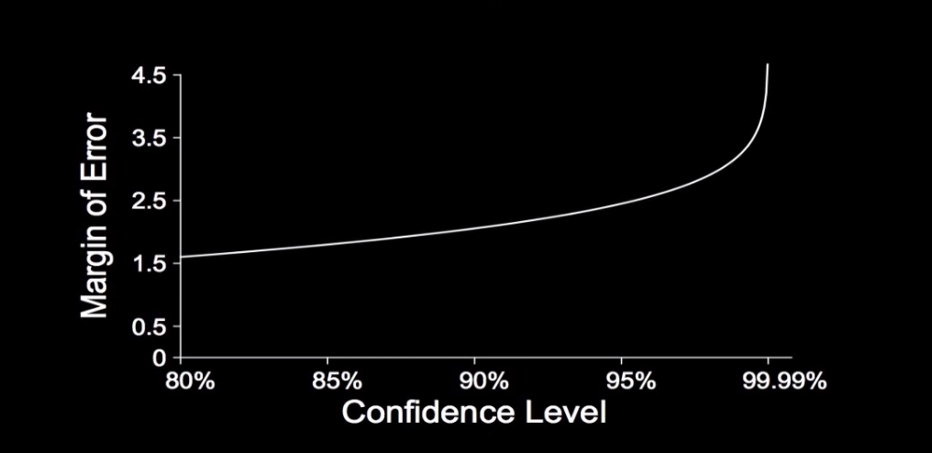
Illustration

Slide 12
References
Statistic How To, 2019. Margin of Error: Definition, How to Calculate in Easy Steps. Retrieved from; https://www.statisticshowto.datasciencecentral.com/probability-and-statistics/hypothesis-testing/margin-of-error/
Roberts, 2019. Margin of Error. Algebra 2. Retrieved from; https://mathbitsnotebook.com/Algebra2/Statistics/STmarginError.html

